Slide 1


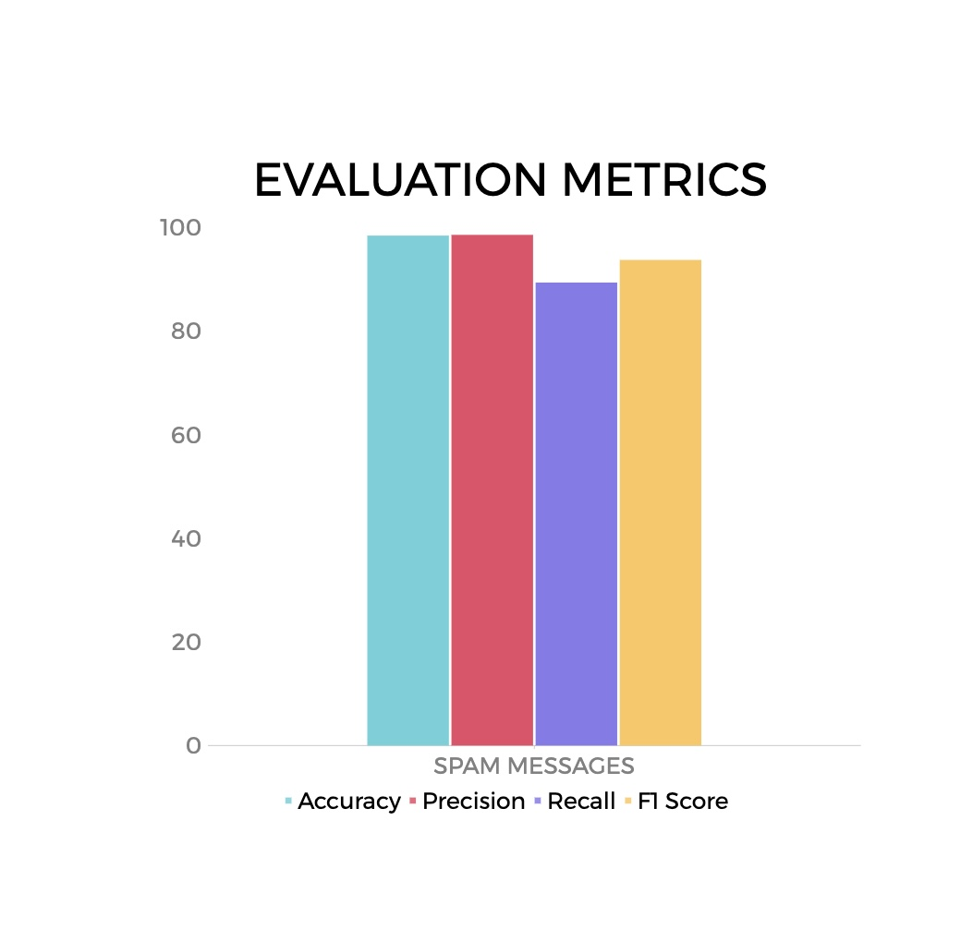
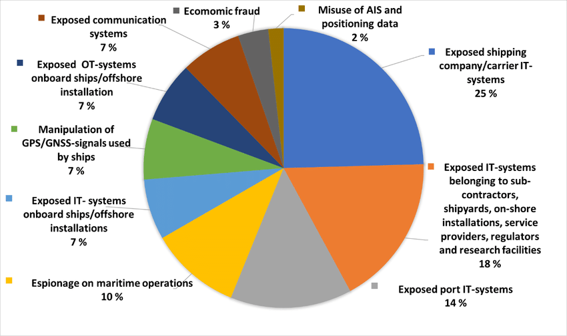
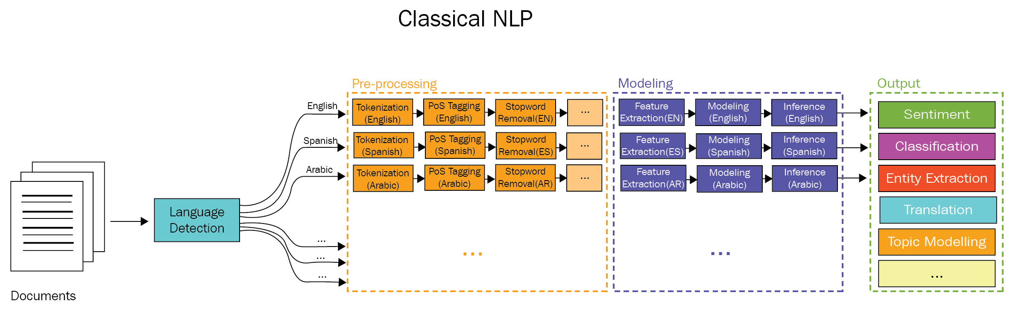
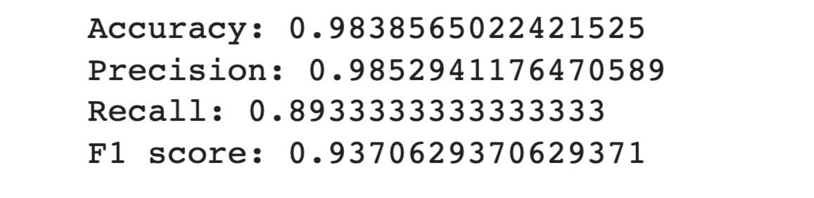
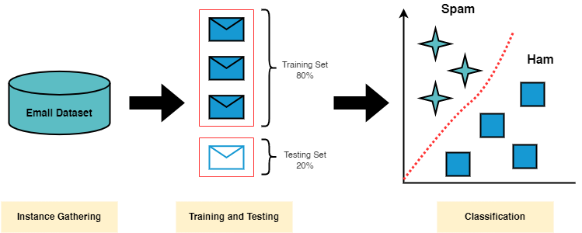
Bridging the Knowledge Gap: Practical Applications of NLP in Cybersecurity
Author: Mishika Kansal Mentor: Janyl Jumadinova
Introduction
Protoype
Information
The application of artificial intelligence to the interplay of computers and human language is known as natural language processing, or NLP. NLP is essential for analysing and comprehending textual data in the context of cybersecurity in order to spot and stop cyberattacks. Cybersecurity procedures can gain from qualitative risk assessments and the provision of helpful tips by utilising NLP approaches.
The research paper aims to develop a prototype for detecting spam messages using machine learning and deep learning techniques. The methodology involves the following steps: 1.Research Objective:
2. Data Collection:
Collect a large dataset of SMS messages, including both spam and non-spam messages.
3.Data Preprocessing: Perform text preprocessing techniques such as tokenization, stop word removal, and stemming/lemmatization to prepare the text data for analysis..
KNOWLEDGE GAP:
A knowledge gap exists in the practical applications of NLP in cybersecurity for detecting and preventing cyber attacks. While research studies have explored the theoretical aspects, there is a need for more research on the implementation and real-world applications of NLP techniques in cybersecurity workflows.
RESULTS:
After testing the model on a labelled dataset the following results were obtained
The prototype for detecting spam messages achieved high accuracy, precision, recall, and F1-score. The accuracy of the prototype is 0.9838565022421525, indicating that the model correctly classified 98.39% of the messages as spam or non-spam. The precision of the prototype is 0.9852941176470589, indicating that out of all the messages predicted as spam, 98.53% were actually spam. The recall of the prototype is 0.8933333333333333, indicating that out of all the actual spam messages, 89.33% were correctly identified as spam. The F1-score of the prototype is 0.9370629370629371, which is a weighted average of the precision and recall, indicating the overall effectiveness of the prototype in detecting spam messages.
4.Feature Extraction:
Extract relevant features from the preprocessed text data, such as word frequency, n-grams, and semantic features.
5.Model Development:
Select appropriate machine learning and deep learning algorithms for spam detection, such as Naive Bayes.
6.Model Evaluation:
Evaluate the trained models using appropriate evaluation metrics
Summary
7. Prototype Development: Develop a prototype application that incorporates the trained model for real-time spam detection.
8.Testing and Validation:
Test the prototype application using a dataset of SMS messages.
9. Results and Analysis:
Analyze the performance of the prototype in terms of accuracy, precision, recall, and F1-score.
Discuss the strengths and limitations of the developed prototype.
In conclusion, promising results have been obtained from research on creating a prototype for identifying spam messages using machine learning and NLP techniques. The prototype successfully distinguished between spam and non-spam messages with high accuracy, precision, recall, and F1-score. These findings are consistent with those of other studies that investigated similar strategies for spam detection.
The successful creation of the prototype demonstrates the potential of machine learning and NLP methods in addressing the spam message problem, which is a growing issue. Utilising these technologies can help individuals and organisations better recognise and filter out messages that could be harmful, increasing communication security overall.The results of this study add to the body of knowledge in the field of spam detection and show how machine learning and NLP can be used to solve real-world cybersecurity problems. The prototype serves as a proof-of-concept for how well these methods work in practical settings.
It's crucial to recognise the study's limitations, though. It is necessary to conduct more research to examine the prototype's scalability, robustness, performance with various spam message types, and performance in various linguistic contexts.
In cybersecurity processes,NLP is crucial for qualitative risk evaluations and tip-offs. Because it gives computers the ability to understand both human and non-human language,it helps businesses to keep ahead of developing cybersecurity risks. NLP can help guard against breaches, identify them, and analyse their size and extent, improving the cybersecurity posture as whole Numerous studies have looked into the application of NLP in cybersecurity. For instance, research has concentrated on using NLP methods to gauge the seriousness of text-based cybersecurity vulnerabilities. These studies show how NLP can improve risk management and cybersecurity procedures.
RESEARCH QUESTIONS: 1.What are the practical applications of NLP in cybersecurity for detecting and preventing cyber attacks?
2.How can NLP be used to detect and prevent phishing attacks?
3.What are the ethical considerations when using NLP in cybersecurity, and how can they be addressed in practical applications?

